Slide 1

ITLPA701: PYTHON AND FUNDAMENTALS OF AI
January 20, 2025
LEARNING UNIT 2–DEVELOP PYTHON CONCEPT
Mr. Etienne NTAMBARA
ntambaraienne94@gmail.com
Assistant Lecturer in ICT Department
Rwanda Polytechnic, IPRC-HUYE
Homepage: https://94etienne.github.io/profile/
Learning hours: 9

Slide 2
Learning Outcomes:
2.1. Writing Python syntax
2.3. Perform declaration
2.4. Defferentiate data type

Slide 3
Learning Outcome 2.1: Writing python syntax
The Python syntax defines a set of rules that are used to create Python statements while writing a Python Program.
Example :
x = 5
Age = 60
Name = “MY NAME”
x, y=8,9
X = 7, Y = 10 => Wrong, float area = 9.0 => wrong
The Python Programming Language Syntax has many similarities to Perl, C, and Java Programming Languages.
However, there are some definite differences between the languages.
Python extension is .py

Slide 4
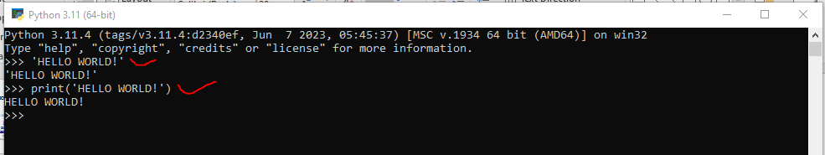
2.1.2. Use command line
Let us execute a Python "Hello, World!" Programs in different modes of programming
2.1.2.1. Python modes
1) Interactive Mode Programming

Slide 5
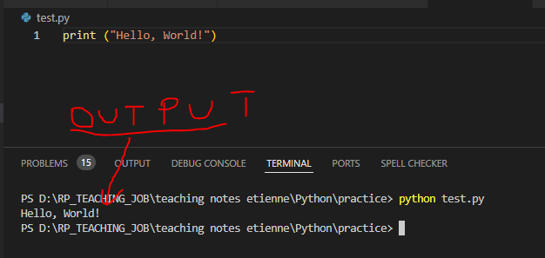
2) Script Mode Programming
We can invoke the Python interpreter with a script parameter which begins the execution of the script and continues until the script is finished. When the script is finished, the interpreter is no longer active.
Let us write a simple Python program in a script which is simple text file. Python files have extension .py.
Type the following source code in a test.py file:

Slide 6
2.1.2.2 Compilation and execution
In python compilation and execution are done whenever you run python program
In terminal or command prompt: Python3 simple_script.py OR Python simple_script.py

Slide 7
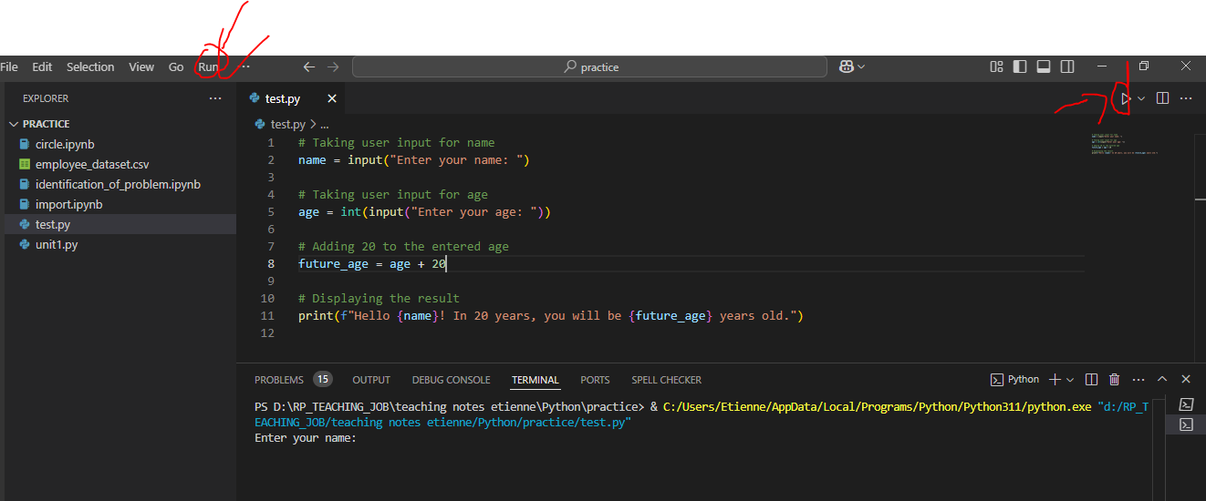
2.1.2.2 Compilation and execution
In GUI (pycharm)

Slide 8
2.1.2.3 Save python project in VSCODE
Go to file
SAVE AS
Or press ctrl + s
2.1.2.4 Identation
Indentation refers to the spaces at the beginning of a code line. Where in other programming languages the indentation in code is for readability only, the indentation in Python is very important. Python uses indentation to indicate a block of code.

Slide 9
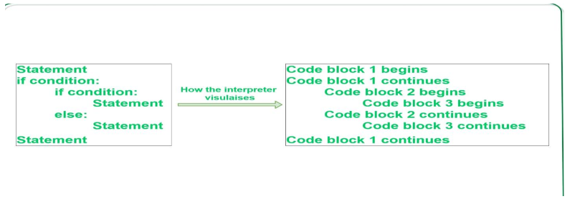
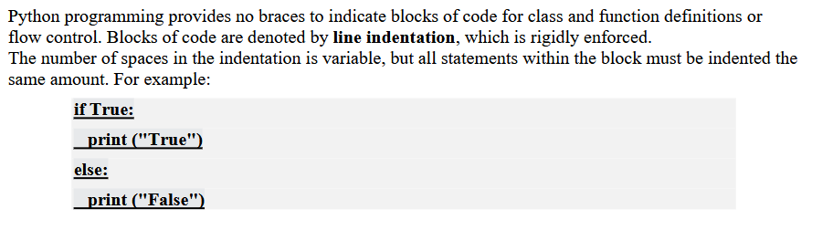
2.1.2.4 Identation

Slide 10
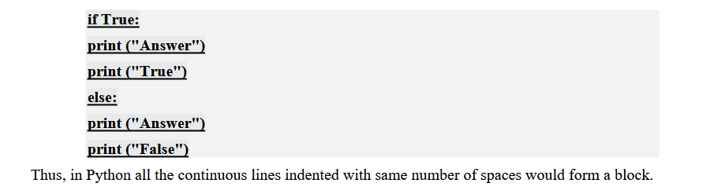
2.1.2.4 Identation
However, the following block generates an error:

Slide 11
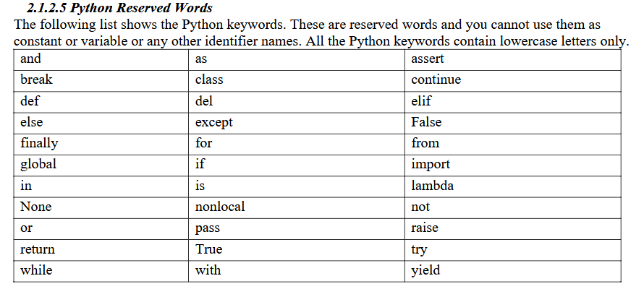
2.1.2.5 Python Reserved Words

Slide 12
2.1.3. Comments in Python
Python comments are programmer-readable explanation or annotations in the Python source code.
They are added with the purpose of making the source code easier for humans to understand, and are ignored by Python interpreter.
Comments enhance the readability of the code and help the programmers to understand the code very carefully.
Just like most modern languages, Python supports single-line (or end-of-line) and multi-line (block) comments.
Python comments are very much similar to the comments available in PHP, BASH and Perl Programming languages.

Slide 13
2.1.3. Comments in Python
There are 2 types of comments available in Python
Single line Comments
Multiline Comments
2.1.3.1. Single Line Comments
A hash sign (#) that is not inside a string literal begins a comment. All characters after the # and up to the end of the physical line are part of the comment and the Python interpreter ignores them
Following is an example of a single line comment in Python: #
# This is a single line comment in python
print ("Hello, World!")
This produces the following result: Hello, World!

Slide 14
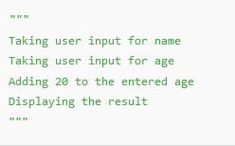
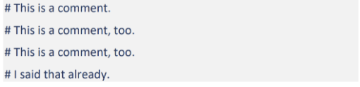
2.1.3. Comments in Python
You can type a comment on the same line after a statement or expression.
name = "Madisetti" # This is again comment
2.1.3.2. Multi-Line Comments
Python does not provide a direct way to comment multiple line. You can comment multiple lines as follows:
Following triple-quoted string is also ignored by Python interpreter and can be used as a multiline comments

Slide 15
QUIZ/ 5 marks
5 minutes

Slide 16
Learning Outcome 2.2: Perform declaration
Page 29, page 213

